Slide 1


Constants of Proportionality
Matrix SV (8x8) gets element-wise divided by (alpha(k) * mu1)
$${\tilde{T}}^{(k)}=\tilde{s}{\tilde{v}}^{T}/(α^{\left(k\right)}μ_{1})$$
Each heatmap will have the same pattern with different scales, since the only thing that changes is the constant alpha(k) in the denominator.
Country | alpha
CAN | 6.114771
CHN | 7.358265
GBR | 4.737637
ISR | 5.289702
ITA | 7.978819
NLD | 8.609081
General Observations:
Hottest spots are on the columns for children and elderly, which is caused by their very high viral infectiousness.
Low susceptibility in children and teens lead to very weak rows. (possibly implying schools aren’t the main breeding ground for epidemics)
United Kingdom has the lowest alpha, which leads to the highest values on the heatmap. I think this implies that the virus spreads more rapidly in the UK?
Infectious period $μ_{1}=5.0$

Slide 2
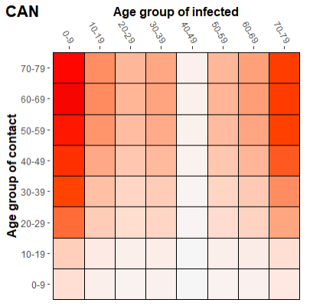

Canada

Slide 3
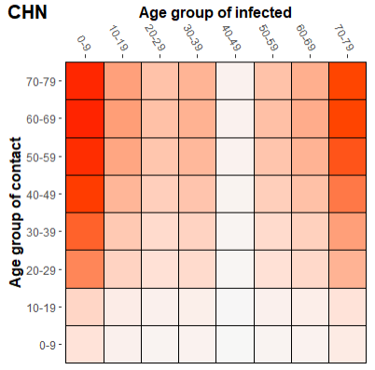
China

Slide 4
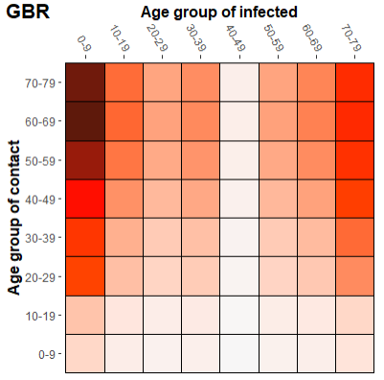
United Kingdom

Slide 5
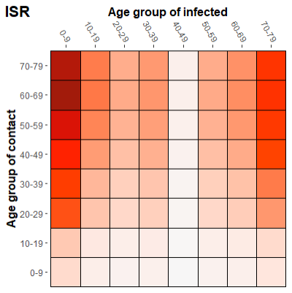
Israel

Slide 6

Italy

Slide 7
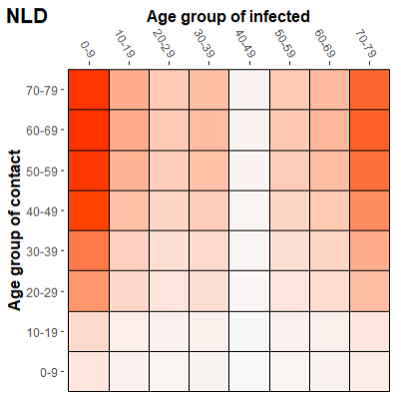
Netherlands

